Slide 1
COVID-19 Return to THE workplace
Architecture of the
Retour au Lieu de Travail –
Return to the Workplace
Application
Presentation to ACMB (secretarial)
November 3, 2020

Slide 2
refresher
ECCC is planning for the phased return of its workforce to the workplace
A tool is required to help manage a safe return to the workplace
Safety of employees, contractors, visitors while in ECCC buildings per HC guidelines is the primary consideration
Options analysis was presented to ACMB and endorsed August 20
Decision was to implement the DoJ application at ECCC
Returning to ACMB now to seek endorsement of the architecture

Slide 3
OVERVIEW and context
The application/tool will:
Be used by employees and others such as contractors and visitors to submit requests to access a floor or section of a building on a given day and time
Be used by managers to review and approve requests
Limit the number of people in a floor/section to a predefined capacity
Obtain an attestation from employees they will abide by COVID-19 health and safety procedures
Keep records of who was approved to be present
Real Property (CSFB) is the lead on this initiative and the business owner of the application
Other stakeholders include Senior Building Officers and Security
OCIO is a partner in the delivery of a solution/application
Justice developed the initial tool, based on Microsoft Office 365 (“M365”)
M365 was implemented at ECCC on August 19th
Intent is to share ECCC’s version of the tool back to the community
Application is expected to be decommissioned following the COVID-19 pandemic

Slide 4

timeline
Feasibility: installed DoJ
App as-is in ECCC M365
– Aug 4
Pilot: launched -- Sept 28
PMAC: Gates 0
and 1 endorsed
-- Oct 16
PMAC: Gates 2 and 3 – Oct 29
Production: launch – Nov 9
Operations
Decommission
Post-COVID
Aug 1
Sept 1
Oct 1
Nov 1
Dec 1
Any new
requirements
for subsequent phases of the
return to the
workplace will be treated as a new project
ACMB: options
analysis presented
and endorsed
– Aug 20
Pilot: ready to launch – Sept 21
ACMB: architecture
presented – Nov 3
Production: ready for launch – Nov 6

Slide 5
Who needs to do what in the app?
Actor | Use Case
Staff (anyone with an ec.gc.ca account, including some contractors and OGD staff) | Submit a request for self and register any visitors
Mission Critical User | Submit a request for automatic approval
Proxy User (aka Booking Assistant) | Submit a request on someone’s behalf
Manager | Approve a request
Dashboard User (Real Property, Senior Building Officer) | View capacity utilization dashboard
Visitor (anyone without an ec.gc.ca account) | Receive email notification (approved/declined)
Daily Email Recipient (SBO, Security, Commissionaire) | Receive email report of people expected in building that day
System Administrator (Real Property) | Maintain building, floor, user, dashboard access lists Review feedback survey results
Survey Respondent (any user) | Provide feedback via survey
Equipment Pick-Up Reporter (Finance) | Obtain equipment pick-up data to prepare report for DM
Contact Tracer | Identify potential contacts*

Slide 6
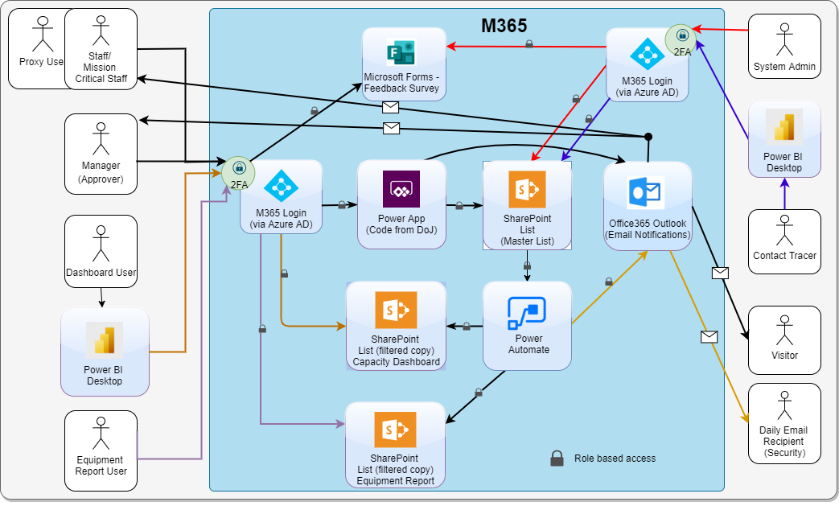
Conceptual Architecture
Note 1: The 2FA-M365
Login is duplicated left
and right to balance the
diagram but these are
one and the same
Note 2: Once Email
Migration takes place,
O365 Outlook will be
ECCC’s new email system
so email delivery to Staff
and Manager will be internal (that is, to their mailboxes in
O365 Outlook)

Slide 7
Side note: A lesson learned
When work began on the RTW app, M365 was still in pilot at ECCC and the M365 Outlook was not yet available
M365 provides another mailer, SendGrid, which was used instead and has been used in the RTW pilot
This turned out to be a third-party service hosted outside ECCC’s M365, with a separate End User Licence Agreement
A lesson for any future development initiatives in M365:
Services are readily available in M365 that could have separate EULA and could be hosted in the US or off shore
Developers will need to validate services against CCCS’s list of evaluated services as part of their development process, as it’s very easy to invoke services that could change the security or data residency picture

Slide 8
Security
Security assessed as PALL
Protected A, Low Availability, Low Integrity
System will store personal email addresses for visitors (those without ec.gc.ca accounts)
Reports of who was in a building on a given day also considered PA in context of possible COVID exposure
ECCC M365 is ULL (Non-sensitive/Low/Low)
However, “urgent needs for working with protected A information, such as the Return to Work application, can be implemented now on M365 with application specific governance” – DCSO to CIO, Sept 2
Application specific governance has been defined for RTW and reviewed with Security (highlights on next slide)

Slide 9
RTW Application specific controls
General
Two-Factor Authentication (2FA) via M365 login and Azure Active Directory controls access to system
Further role-based access controls are placed on the access to the underlying SharePoint lists where data are stored
Visitor personal email addresses
Only known to the employee entering the information
Not visible to the approving manager in the app, Manager not copied on email notification to visitor
Not included in any reports / dashboards
A separate set of SharePoint lists was created with contact information filtered out. Dashboard only has access to this, not to the Master (operational) lists
Lists of who was in a building on a given day
Dashboard presents summary information about capacity utilization, no identifying information, so is non-sensitive
The dashboard SharePoint lists do not contain identifying information
Access to the Master (operational) SharePoint lists, where the personal information resides, is limited to
Certain Real Property personnel (System Administrators), who manage the system, authorized by RP management
Certain OCIO personnel, who develop / support the system, authorized by OCIO management
List of who is expected in a building each day is sent by email only to SBOs and to Security to provide to the Commissionaires
Recipient lists controlled by System Administrators
Each building has a separate recipient list
Individuals expected in the building are identified but contact information is not included

Slide 10
Residual Risk and privacy
Residual risk is assessed to be Low
Accepted by the business owner
Interim SATO for the pilot signed off by DG ARPSD
A full Privacy Impact Assessment (PIA) was not deemed necessary by ATIP
“Privacy Risk Assessment for Non-Administrative Purposes” (PRA -- lighter-weight than PIA) was deemed appropriate and is underway
Privacy Act Statement was prepared early to ensure legal coverage for the collection of information in the pilot
Same Privacy Act Statement applies to the Production release

Slide 11
Other considerations
QA/QC
Separate Dev and Prod spaces set up in M365
Application piloted with 4 buildings before launching to full department (100+ buildings)
45 people submitted User Acceptance Testing reports (nearly 70 people participated)
Completing Application Deployment Oversight (ADO) checklist
Information Management
App is expected to be decommissioned following COVID pandemic
Data retention following decommissioning of the app is being investigated (possible value as historical records?)
Accessibility
The application and the emails it sends are bilingual
Because of the tight timeline, the application is not WCAG2 compliant (full compliance would require redesign)
The request by proxy (booking assistant) feature helps work around this
Key accessibility features supporting navigation by keyboard and high contrast have been implemented
*Contact Tracing
RTW app is not a primary source for contact tracing
There is a specific definition for close contact and only those meeting the definition are to be notified
Privacy must also be respected
Consequently, contact tracing is done by following the chains of contact
RTW app might be consulted as a secondary source but is not a component of the process

Slide 12
Support and maintenance
4 Tiers of support already in place for the pilot:
Tier 0 (self help) – User Guide, FAQ, and recorded Demos posted on Help-Me-IT
Tier 1 – Service Desk as point of contact to create tickets and respond to basic issues like access to the app (e.g., user can’t log in on M365)
Tier 2 – Real Property set up to receive and respond to tickets regarding all aspects of using the app (questions, issues, feedback, etc.)
Tier 3 – Technical issues with the app itself are escalated to IM – EC3 (ECollab / GCdocs team) or to CEPSD for the dashboard
Real Property is empowered to manage the lists of buildings, floors, user settings, and dashboard access privileges without relying on IT to make the updates
No handover between decision and implementation → faster response times for users
Cost in production
Real Property – 1.5 FTE to respond to tickets, feedback from survey, manage building, floor, user, access lists, and dashboard
IT – IM-EC3 0.35 FTE – app deliberately kept simple and developed in a high-level language (PowerApps) so it is robust and will require little maintenance / bug fixing
Subsequent releases
Requirements for subsequent phases of the return to the workplace have not been determined
Any new releases necessary to support subsequent phases will be managed as new projects and costed accordingly

Slide 13
cost

Slide 14
risk
The M365 platform is new to ECCC and the GoC and is expected to evolve, potentially impacting the application
For example, Active Directory Federation is needed for the Email Migration but will cut off access from personal mobile devices
Currently exploring whether M365 guest accounts would work
User’s manager could request a laptop from service desk
Use Booking Assistant feature to have requests submitted by proxy
The app was developed by an ad hoc team assembled on an emergency basis → everyone returns to “day job” after launch
Although support is in place and new releases are to be approached as a new project, the pandemic situation continues to evolve, potentially creating new requirements for urgent changes beyond the scope of support / maintenance
Team may need to be reassembled with little warning, impacting other initiatives
Different resources, not familiar with app, may be called upon (but codebase is small)

Slide 15
Next steps
Complete UAT, perform final bug fixes
Finalize SoS, PRA, obtain sign-offs
Complete ADO checklist
Return to PMAC for Execution and Close-out
Launch in production
Package system up to share back to the community
Stand down development team, transition to operations

Slide 16
Annex

Slide 17
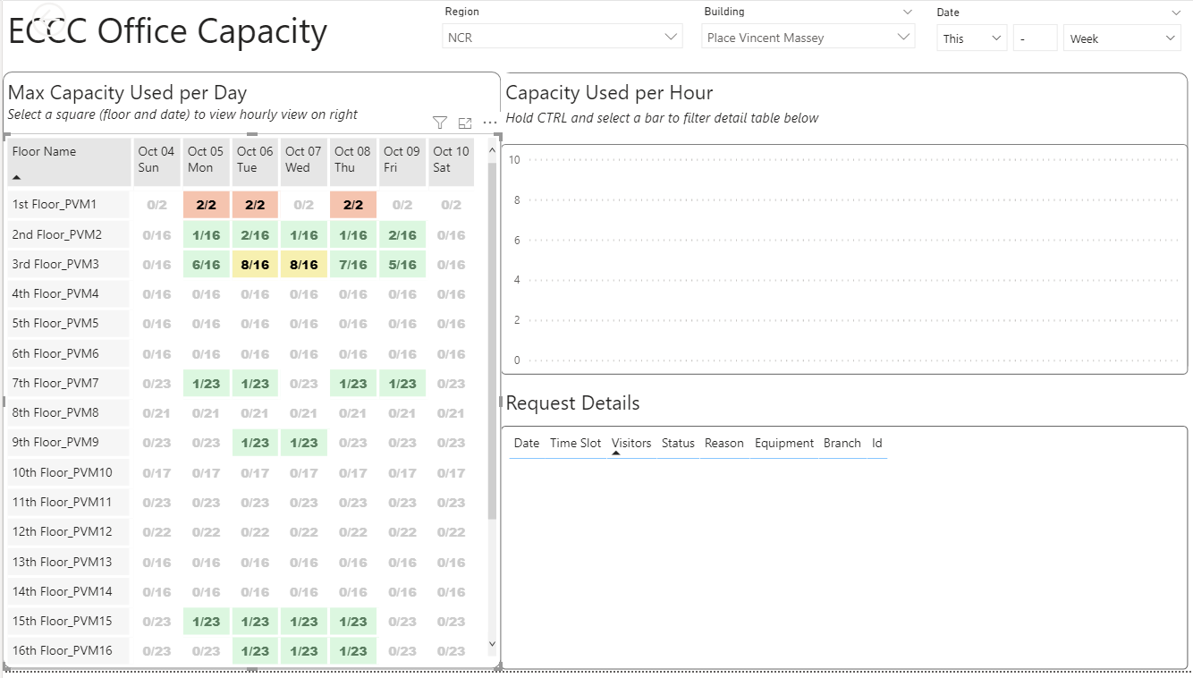
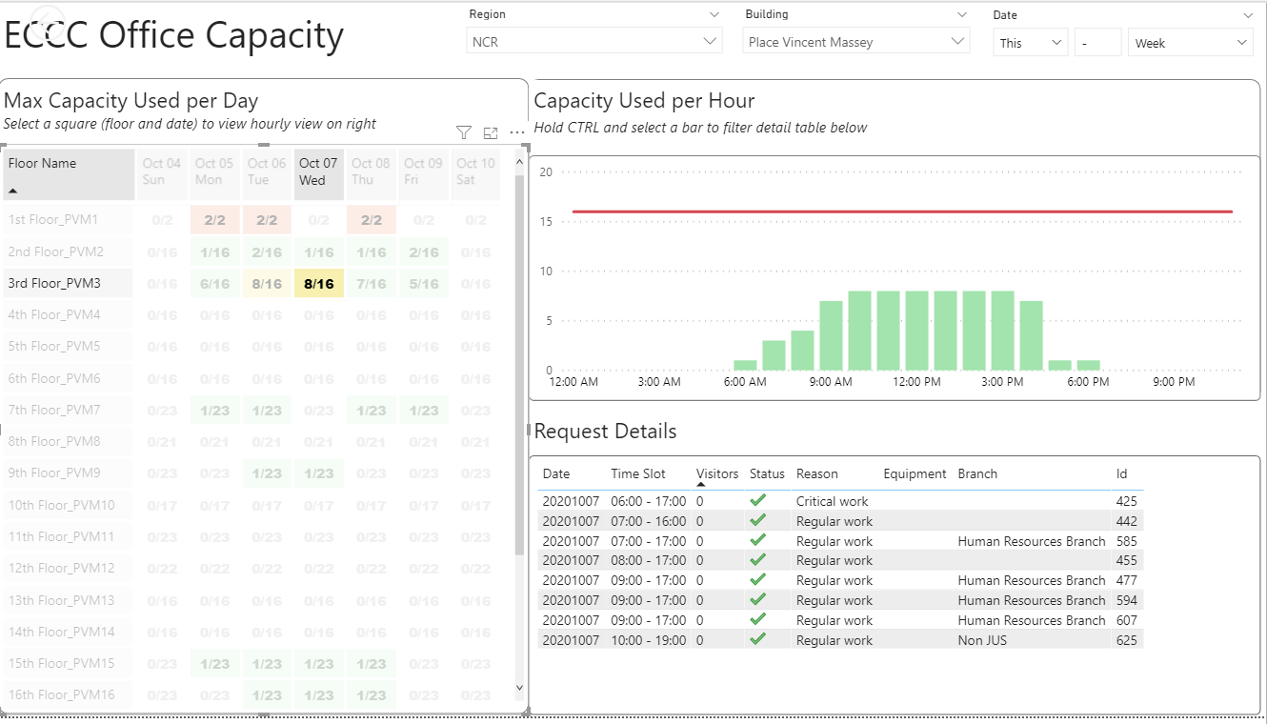
dashboard
Provides an overview of Capacity Utilization by building, floor, date, and time
Allows Real Property and Senior Building Officers to monitor utilization
Identify locations and times where capacity is maxed or getting there
Aggregate only, no identifying information → strictly non-sensitive

